Slide 1
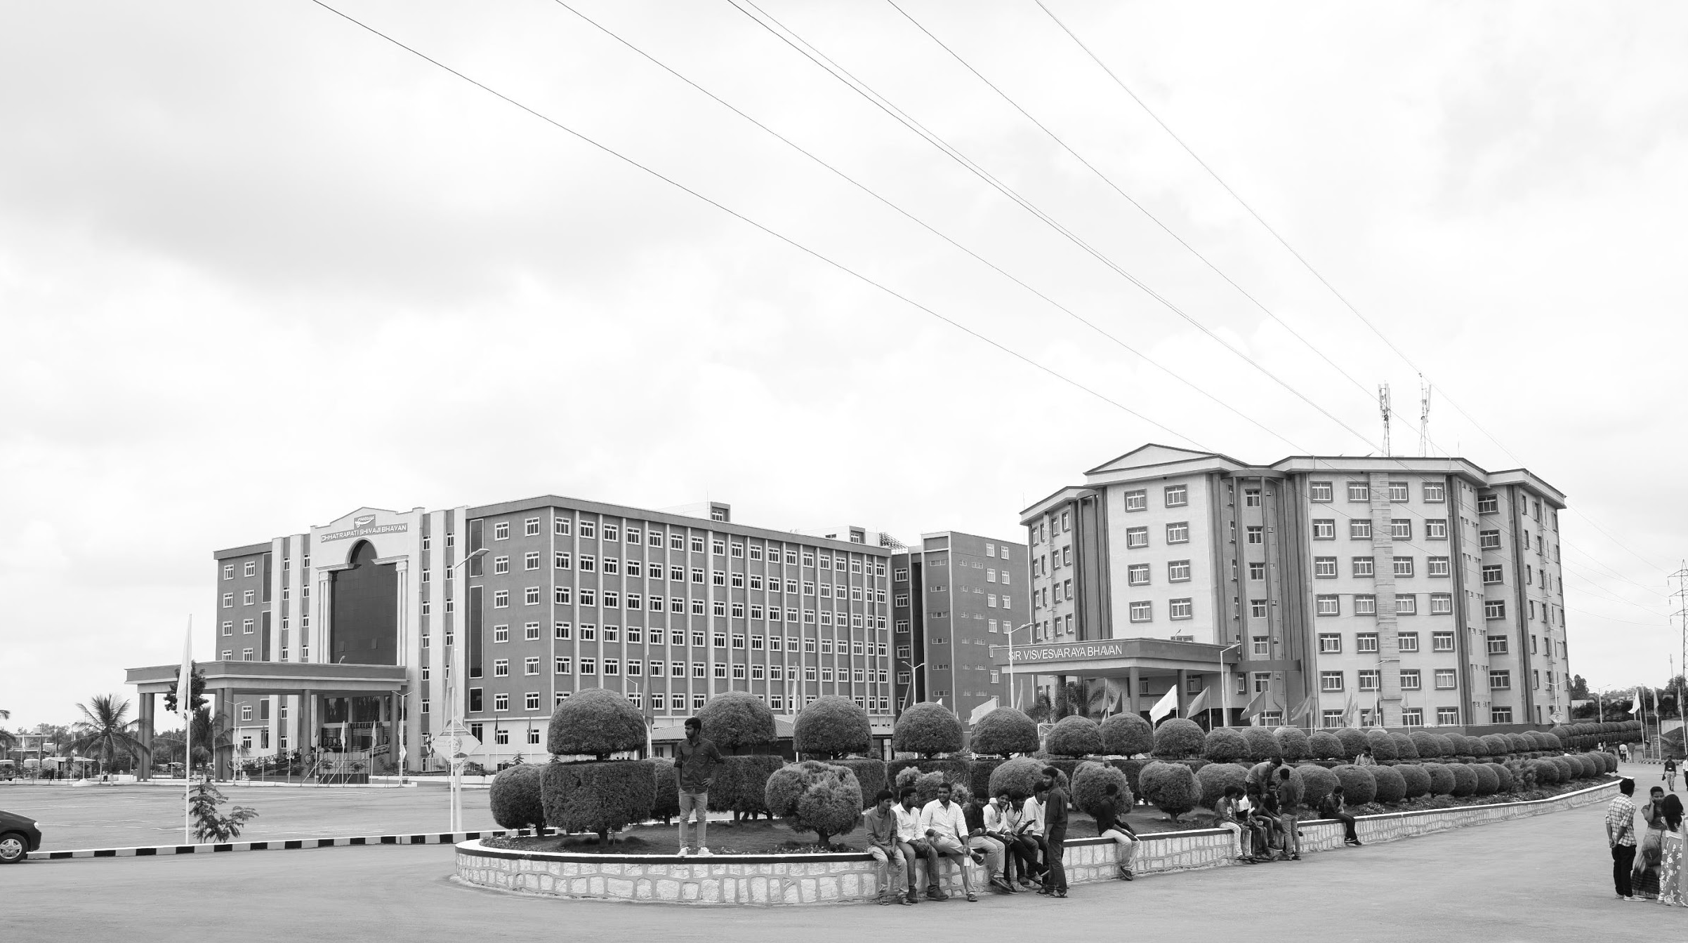

A DESIGN OF METASURFACE/METAMATERIAL BASED EFFICIENT ANTENNAS FOR RF ENERGY HARVESTING AND WIRELESS POWER TRANSMISSION
AY 2021-25
GITAM UNIVERSITY
Major Project
A University should be a place of light, of liberty, and of learning.
Department of Electrical Electronics and Communication Engineering
Project Team:
BU21EECE0100468
BU21EECE0100143
BU21EECE0100201
Project Mentor:
DR.AKHILENDRA PRATAP SINGH
www.gitamedu.com

Slide 2




Project Group – Details
Photo
Track
Roll No
Name
Photo
EECE AI/ML
BU21EECE0100468
P.A.SRUTHI
Photo
EECE AI/ML
D.ASHA BEE
BU21EECE0100143
Photo
EECE AI/ML
BU21EECE0100201
G.DHATHRI

Slide 3
Objective and Goals
Objective
To design and optimize microstrip patch antennas using HFSS for RF energy harvesting and wireless power transmission in the 1 to 10 GHz frequency range, focusing on improving gain, radiation pattern, dielectric properties, and frequency performance. The research aims to develop an efficient antenna system that maximizes energy capture and transmission under ambient conditions.
Goals
Main Goals
Enhancing Antenna Gain
Improving Radiation Pattern
Maximizing Frequency Performance
Optimizing Dielectric Properties

Slide 4
ABSRACT
The increasing demand for sustainable energy solutions has spurred interest in Radio Frequency (RF) energy harvesting and wireless energy transmission as viable alternatives for powering low-power electronic devices. This project will focus on the design and development an efficient antenna based on meta surface/metamaterial structures, specifically tailored for RF energy harvesting and wireless energy transmission applications. The project will involve the systematic design of meta surface/metamaterial-based antennas, beginning with the selection of appropriate metamaterial unit cells. These unit cells will be optimized and arranged to achieve superior electromagnetic properties, such as enhanced wave manipulation, improved impedance matching, and increased directivity. The antenna will designed using advanced simulation software to operate across a wide range of frequencies to effectively capture ambient RF energy and convert it into electrical power. Through simulation and experimental validation, the project will demonstrate the enhanced performance of the meta surface/metamaterial-based antenna in terms of efficiency and compactness compared to conventional antenna designs. The antenna's ability to operate efficiently across multiple frequency bands and its compact design will make it an ideal candidate for integration into various energy harvesting and wireless power transmission systems. The outcomes of this project are expected to contribute to the advancement of wireless energy transmission technologies, providing a foundation for more sustainable and efficient energy solutions.​

Slide 5
INTRODUCTION :​
RF Energy Harvesting (RFEH): This technology captures and converts ambient radio frequency (RF) signals into usable electrical energy. It plays a critical role in powering low-energy devices like IoT sensors, wearable electronics, and remote monitoring systems without relying on batteries or wired connections.​
Wireless Power Transmission (WPT): WPT refers to transmitting power from a source to a receiver without physical connectors. It uses electromagnetic fields to transfer energy, which can be applied over short and long distances, depending on the technology and frequency range.​
Metamaterials/ Meta surfaces: These are artificially structured materials engineered to manipulate electromagnetic waves in ways that natural materials cannot. Metamaterials can control wave propagation, reflection, absorption, and refraction, offering unprecedented control over RF signals.​

Slide 6
Literature Survey
s:no | TITTLE | AUTHOR | YEAR OF PUBLISHING | DRAW BACKS
1 | Design of RF energy harvesting Antenna using optimization techniques | Vijay Gokul(MCE, Madurai),M. Suba Lakshmi,TSweta | April 2020 | Limited Frequencies Reliance on Simulations Complicated Methods Lack of Practical Use
2 | Design and implementation of microstrip patch antenna | John Colaco,Rajesh Lohani | 2020 | 5g application Bandwidth limitation radiation pattern gain and efficiency
3 | Circularly polarized microstrip patch antenna with tilted patch and DGS for ambient RF energy harvesting | Parul Saini,Shivani Malhotra,Lipika Gupta | 2024 | Limited Frequency Range Reliance on Simulations Complex Design Environmental Impact Not Addressed

Slide 7
REFERENCES
Design of RF Energy Harvesting Antenna using Optimization Techniques April 2020 International Journal of Engineering Research and V9(03)V9(03)DOI:10.17577/IJERTV9IS030458Authors:Vijay Gokul(MCE, Madurai),M. Suba Lakshmi,TSwetha https://www.researchgate.net/publication/341875241_
Design and implementation of microstrip patch antenna https://scholar.google.co.in/scholar?start=10&q=ieee+papers+for+design+of+microstrip+patch+antenna+for+5g+application&hl=en&as_sdt=0,5&as_vis=1#d=gs_qabs&t=1729599737999&u=%23p%3DPPP7U7f59JwJ
Circularly polarized microstrip patch antenna with tilted patch and DGS for ambient RF energy harvesting https://ieeexplore.ieee.org/document/10698717

Slide 8
Analysis - SWOT
Strengths
Weaknesses
W1. Complex Fabrication and Cost
W2. Environmental Sensitivity
W3. Limited Practical Implementation
S1. Innovative Technology
S2. High Efficiency and Compact Design
S3. Wideband and Multiband Operation
Threats
T1.Competitive Technologies
T2. Regulatory and Safety Concerns
T3.Market Acceptance and Awareness
Opportunities
O1. Growing Demand for Wireless Power Solutions
02. Advancements in Fabrication Technologies
O3. Integration with 5G/6G Networks

Slide 9
Analysis – 4W1H
Why:
Design and develop metasurface/metamaterial-based antennas for efficient RF energy harvesting and wireless power transmission.
The project focuses on creating compact, highly efficient antennas with wideband/multiband operation for sustainable power solutions.
What:
To address the need for sustainable, battery-free power solutions in IoT devices, wearables, and medical implants.
It aims to advance antenna technology by overcoming limitations of traditional designs like poor efficiency and large size.
Where:
Applicable in IoT sensors, wearable devices, medical implants, and remote monitoring systems needing compact energy solutions.
Also useful in advanced telecommunications networks (e.g., 5G/6G) for simultaneous data transmission and energy harvesting.
When:
The project is typically conducted over a multi-phase timeline, starting with research and design, followed by simulation and optimization.
How:
Using HFSS SOFTWARE

Slide 10
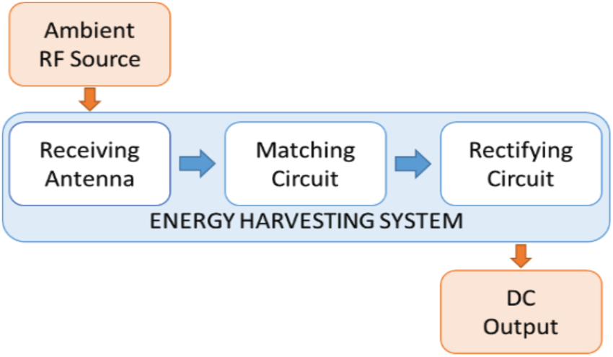
Architecture
Structural Diagram
block diagram
resource:
https://www.researchgate.net/figure/RF-energy-harvesting-system-block-diagram_fig1_330362458

Slide 11
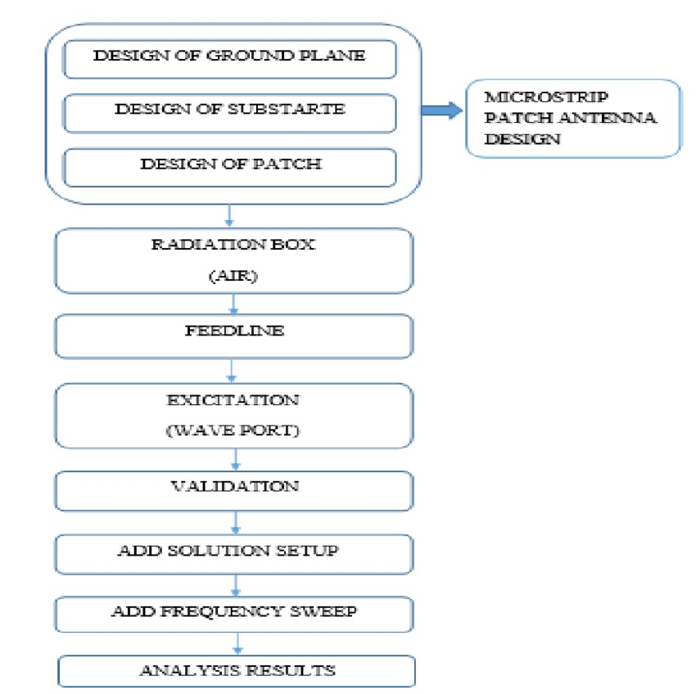
Behaviour Diagram
flow chat:

Slide 12
Use Cases & Testing
USE CASES
Wireless Sensor Networks (WSNs)
Use Case: Sensors in remote or hard-to-reach places (e.g., agriculture or industrial monitoring) can use RF energy from nearby signals (like Wi-Fi) to power themselves.
Benefit: Reduces the need for batteries and manual maintenance.
IoT Devices
Use Case: Devices like smart home sensors can collect power from RF signals, extending their battery life or eliminating the need for charging.
Benefit: Makes IoT devices more reliable and energy-efficient.
Wearable Electronics
Use Case: Fitness trackers and medical wearables can harvest energy from surrounding RF signals, reducing the need for frequent charging.
Benefit: Increases convenience and usability for users.
Smart Agriculture
Use Case: Sensors in fields can be powered by RF signals to monitor soil and crops without needing battery replacements.
Benefit: Saves time and cost for farmers by reducing manual maintenance.
Medical Implants
Use Case: Devices like pacemakers can be powered by RF energy, reducing the need for surgeries to replace batteries.
Benefit: Improves patient safety and comfort.
Asset Tracking
Use Case: RFID tags or tracking devices on shipping containers can use RF energy to report their location without requiring batteries.
Benefit: Allows real-time tracking without frequent battery changes.

Slide 13
TEST CASES
Test Case: Impedance Matching
Objective: Ensure the antenna is well-tuned to collect RF energy efficiently.
Test: Adjust the antenna size to match the energy collection circuit. Check the reflection (S11) to see if it’s below -10 dB.
Expected Result: The antenna should collect energy effectively at the chosen frequency, with low reflection.
Test Case: Antenna Radiation Pattern
Objective: Test how the antenna radiates or collects energy from different directions.
Test: Simulate the radiation pattern of the antenna in HFSS.
Expected Result: The antenna should direct most of the energy toward the desired direction for better performance.
Test Case: Antenna Gain
Objective: Verify the antenna’s ability to focus energy in a specific direction (directional gain).
Test: Simulate the antenna's far-field radiation pattern in HFSS and calculate the gain (in dBi).
Expected Result: The antenna should have a gain of 5–10 dBi or higher in the main direction to ensure efficient energy harvesting in that direction.
Test Case: Gain vs Frequency
Objective: Test how the antenna gain varies over different frequencies.
Test: Simulate the gain across a range of frequencies (e.g., 900 MHz to 2.4 GHz).
Expected Result: The antenna should maintain relatively high gain across the desired frequency range, with minimal loss in performance.

Slide 14
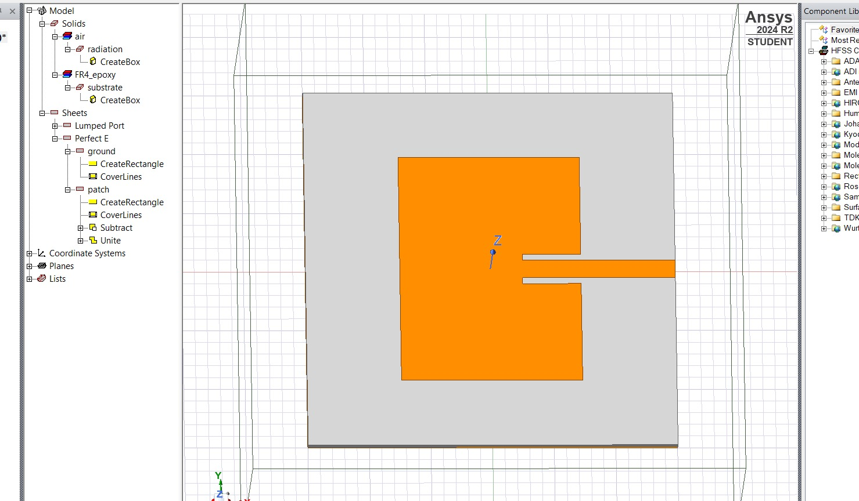
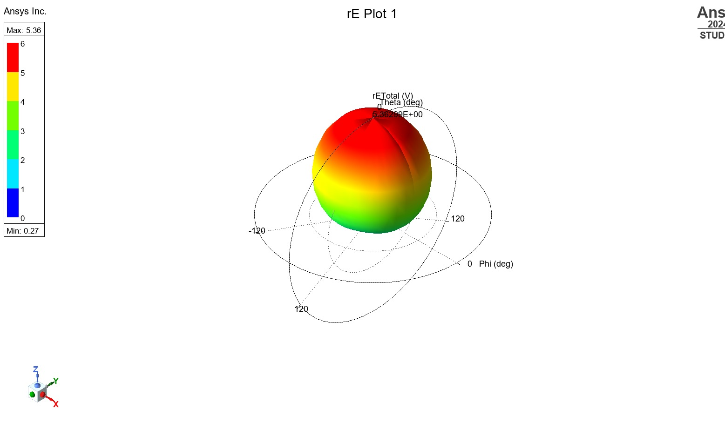
Implementation and Results – Iteration 1
Iteration 1 : Results
RECTANGULAR MICROSTRIP PATCH ANTENNA:

Slide 15
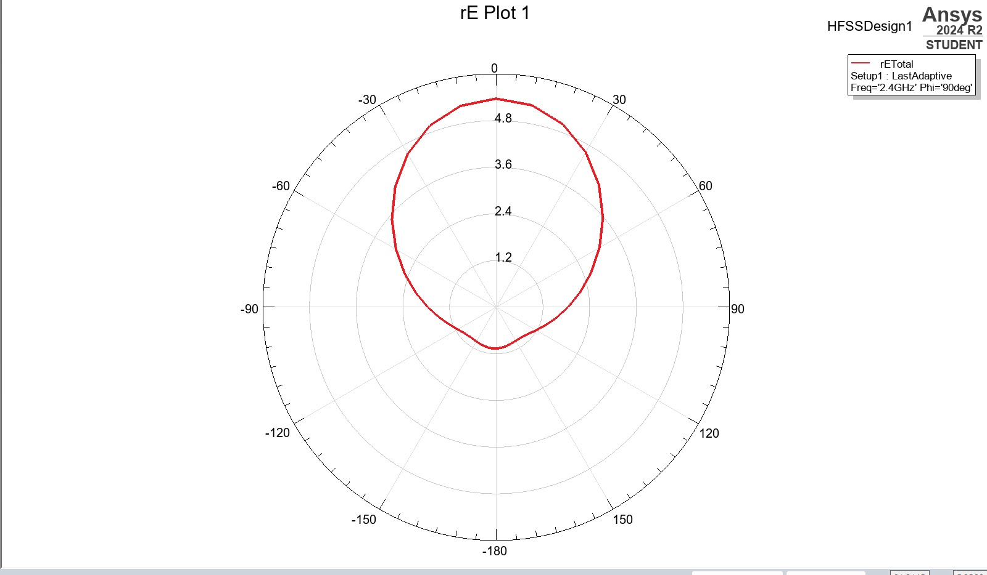
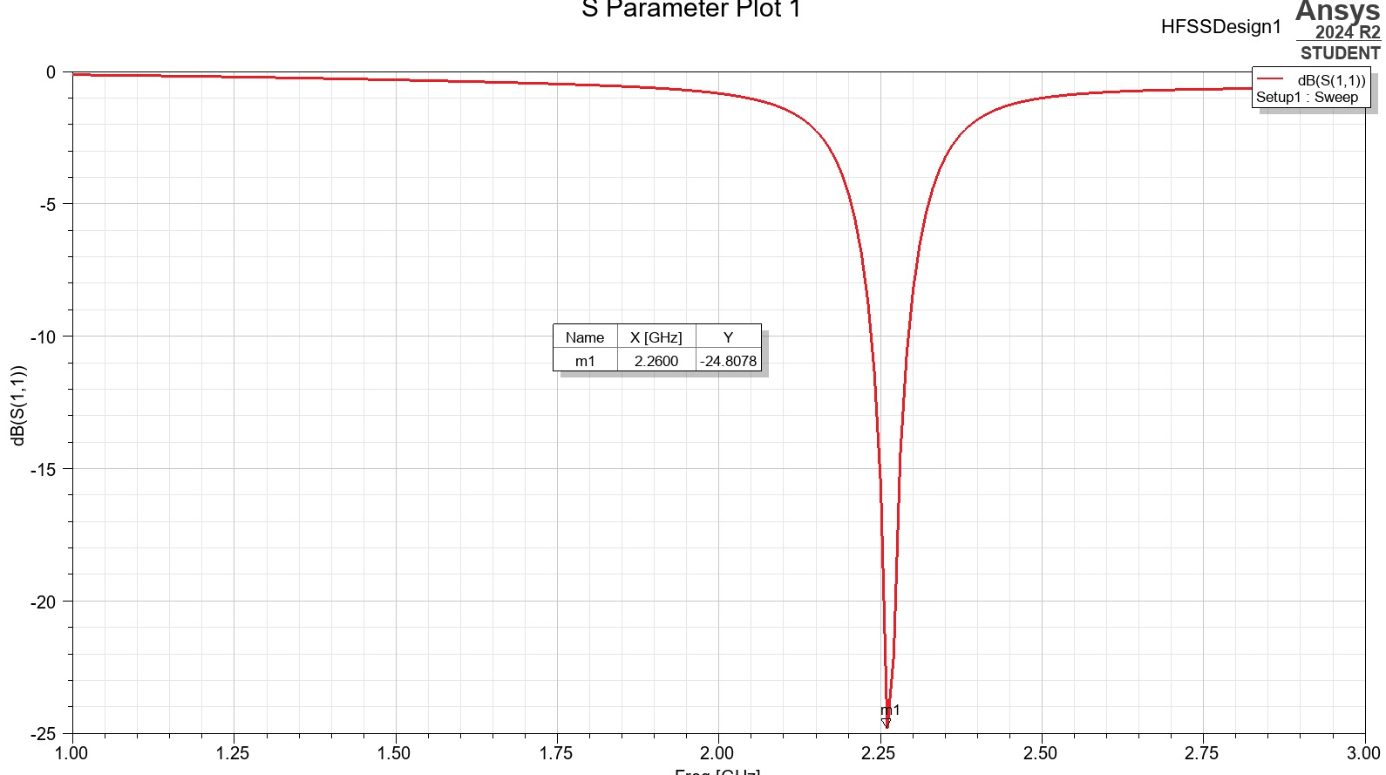
Implementation and Results – Iteration 2
Iteration :

Slide 16
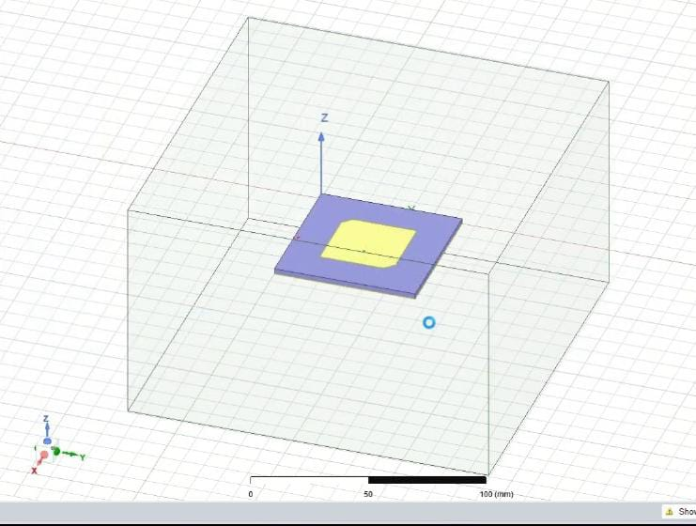
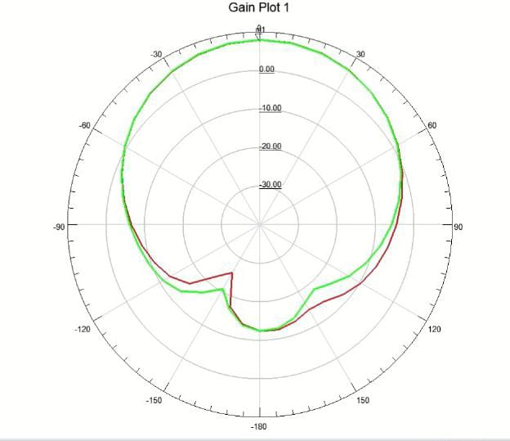
Implementation and Results – Iteration 3 (Optional)
Iteration : Results
CIRCULARLY POLARIZED MICROSTRIP ANTENNA:

Slide 17
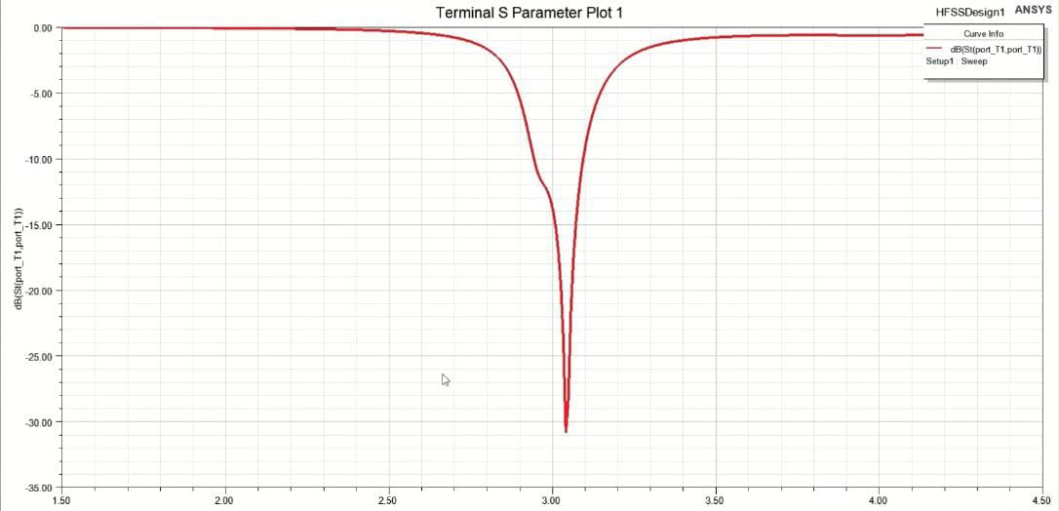
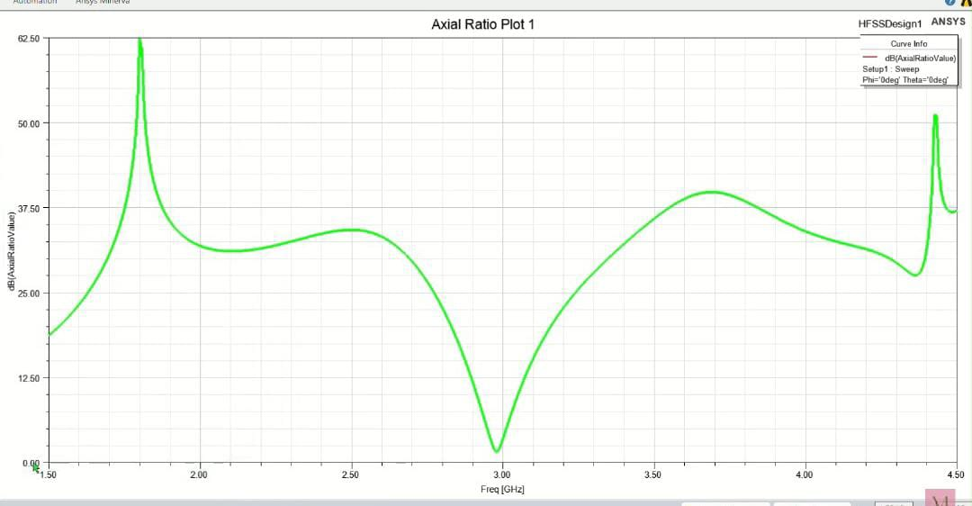
Iteration:

Slide 18
Contribution
Team Progress and Movement
Our team has made significant progress, though the project is still ongoing:
Antenna Design and Simulation: We have completed the initial design and simulation of the rectangular patch antenna (2.45 GHz) using HFSS software. Work on the circular patch antenna (3 GHz) is still in progress.
Research and References: Team members have gathered several key research papers that are helping us refine our designs and improve antenna performance.
Resource Management: We have successfully obtained the necessary tools and software to carry out the simulations. Additional materials are being sourced for the next phase of the project.
Presentation and Report Preparation: Preliminary work on the final report and presentation has begun, but these deliverables will be finalized once the antenna simulations are completed.
While we've achieved several key milestones, more work is needed to complete the remaining tasks.

Slide 19
Individual Contribution
Key contributions: P.A.SRUTHI
Completed the design and simulation of the rectangular patch antenna at 2.45 GHz and the circular patch antenna at 3 GHz using HFSS software
prepared a final presentation PPT and poster
collected the reference papers for the further designing of antenna
Key contributions: D.ASHA BEE
collected the reference paperes for the further designing of antenna
helped for the resourses providing for the project
Designed the circular patch antenna at 3 GHz using HFSS software
Key contribution: G.DHATHRI
Designed the circular patch antenna at 3 GHz using HFSS software
collected reference papers for the antenna designing
prepared final report of the project

Slide 20
Conclusion & Future Work
Summary and Conclusion
Our project focused on the design and simulation of efficient antennas for RF energy harvesting and wireless energy transmission using metamaterials and metasurfaces. We successfully designed and simulated a rectangular patch antenna operating at 2.45 GHz and are in progress with the circular patch antenna at 3 GHz using HFSS software. Throughout the project, we gathered key reference papers, optimized the design process, and ensured that the necessary tools and resources were available to meet our objectives.
Future Work
While the project is still in progress, the initial results from the rectangular patch antenna simulation are promising. Once the design and simulation of the circular patch antenna are completed, we anticipate further improvements in performance. The combination of metamaterials and optimized antenna design holds great potential for enhancing RF energy harvesting. This project sets the foundation for future research in efficient wireless energy transmission, which could have significant implications for sustainable energy technologies and advancing wireless communication systems.

Slide 21

THANK YOU

